Slide 1

KNAPSACK METHOD
Name : Roger Moore A. Sangol

Slide 2

The business owner wants to sell his product but the capacity of his tricycle is only 40 kg
Scenario

Slide 3

Items
TV
Value :1000
Weight: 10kg
Washing machine
Air Condiiton
Value : 3000
Weight: 20kg
Value : 2500
Weight: 18kg

Slide 4

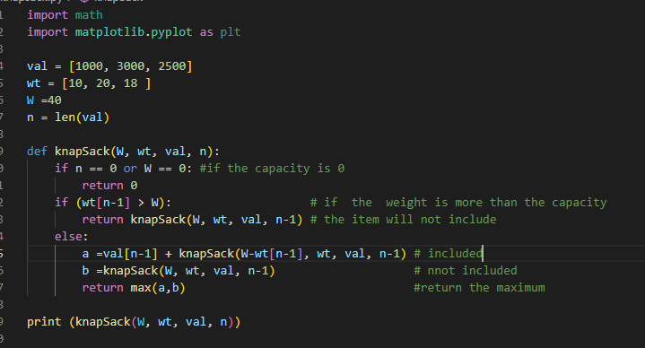
Codes and some Explanation

Slide 5
Thank You
someone@example.com

